Slide 1
DIVIDE
AND
CONQUER
MergeSort
Strassen’s Matrix Multiplication
And Master Theorem

Slide 2
MERGE-SORT
An O(nlogn) Comparison Sort

Slide 3
PROBLEM: Sort a LIST of n numbers
Split the List into two equal halves
Recursively sort each half
Then merge the two sorted sub-lists.

Slide 4
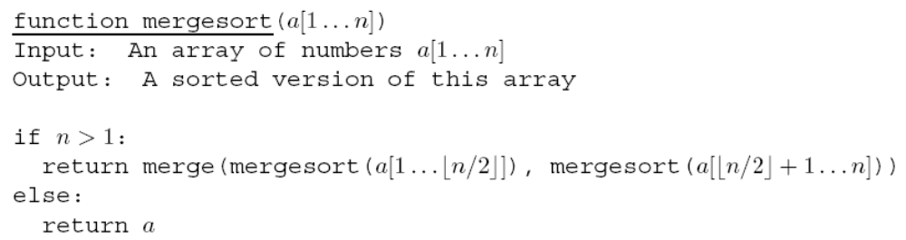
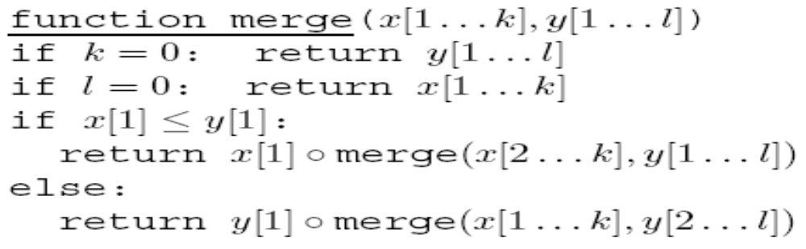

From the TEXTBOOK

Slide 5
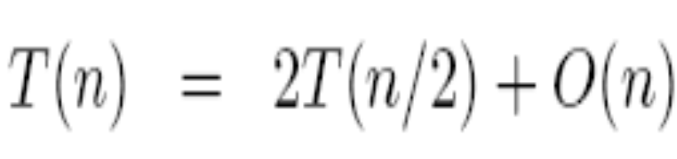
MergeSort (Contd.)
This merge procedure does a constant amount of work per recursive call …
… O(k + l) number of calls
Thus, merge is linear in n
Overall time taken by mergesort is:

Slide 6
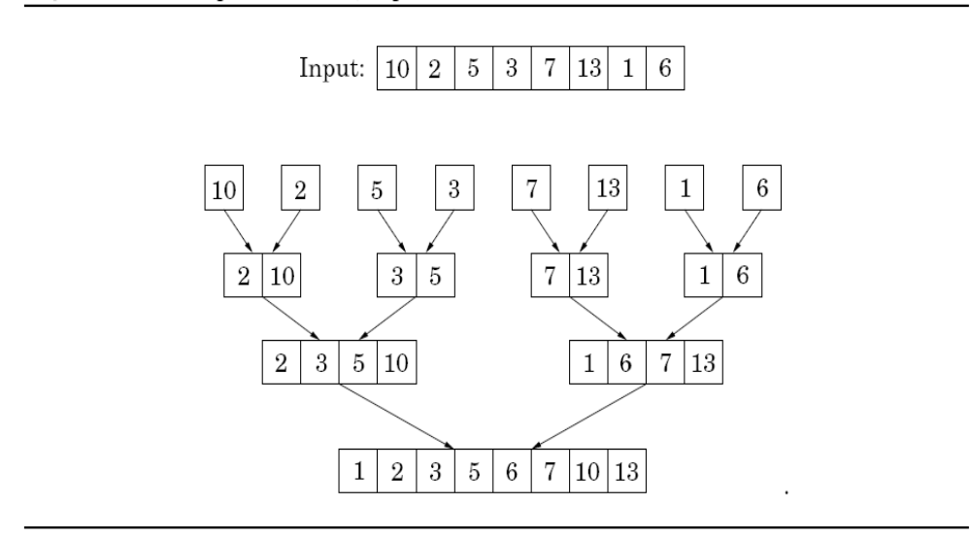
AN EXAMPLE
Most of the work in done by merge, which doesn’t start, up to the recursion gets down to singleton sublists!

Slide 7
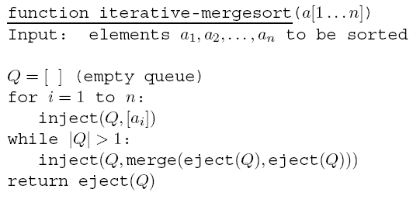
ITERATIVE MERGESORT

Slide 8
Ω(nlogn) LOWER BOUND FOR COMPARISON-BASED SORTING
There are n! permutations (say ordered from 0 to n!-1)
If a sorting algorithm did k comparisons to sort any set of n numbers, then we may use it to represent the numbers between 0 to n!-1 using k bits (why?)
Consequently, k is at least log₂(n!)

Slide 9
MERGESORT is OPTIMAL
Log₂(n!) is Ω(nlogn)

Slide 10
MATRIX MULTIPLICATION
Naïve: O(n³)
Strassen: O(n^{log7})
Fastest Known: O(n^{2.37})
Optimum: Open!

Slide 11
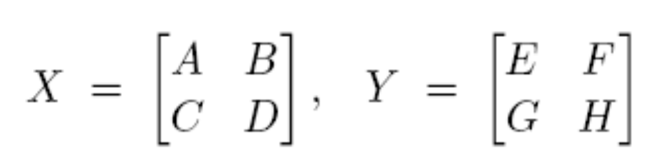
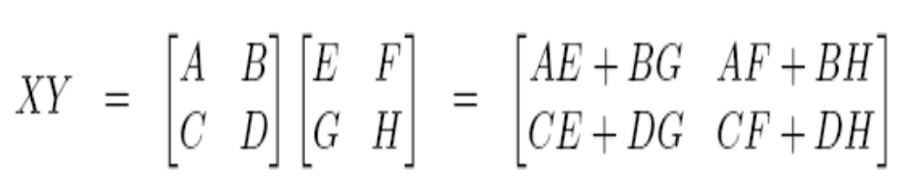


Divide And Conquer
Eight n/2-sized products: AE,BG,AF,BH,CE,DG,CF and DH
entails

Slide 12
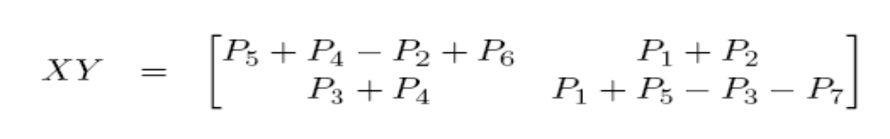
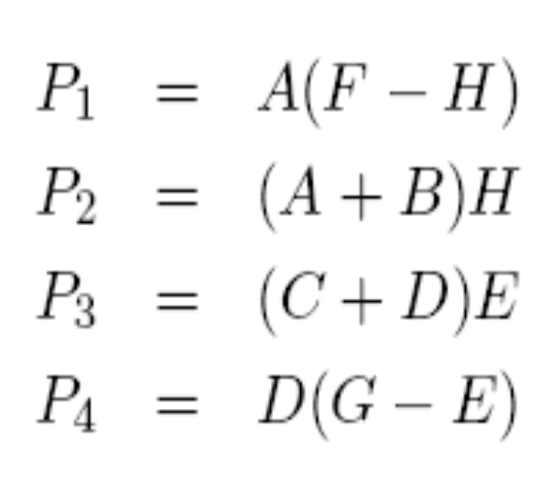
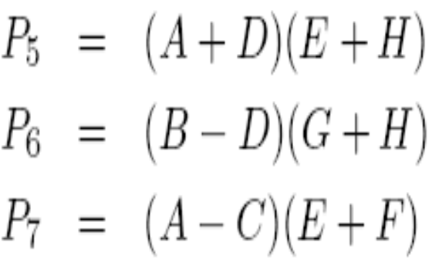
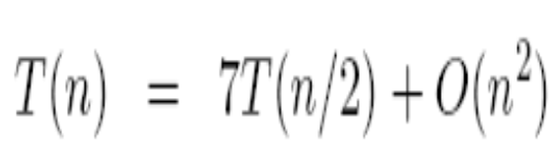
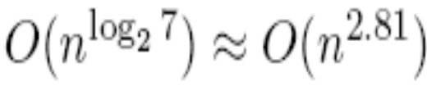
Strassen’s Algorithm

Slide 13
Recurrence Relations
Master Theorem

Slide 14
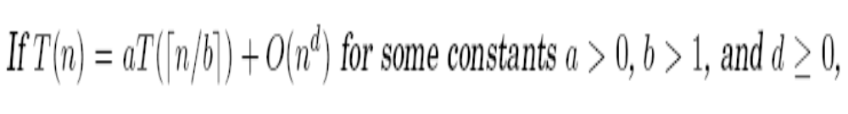
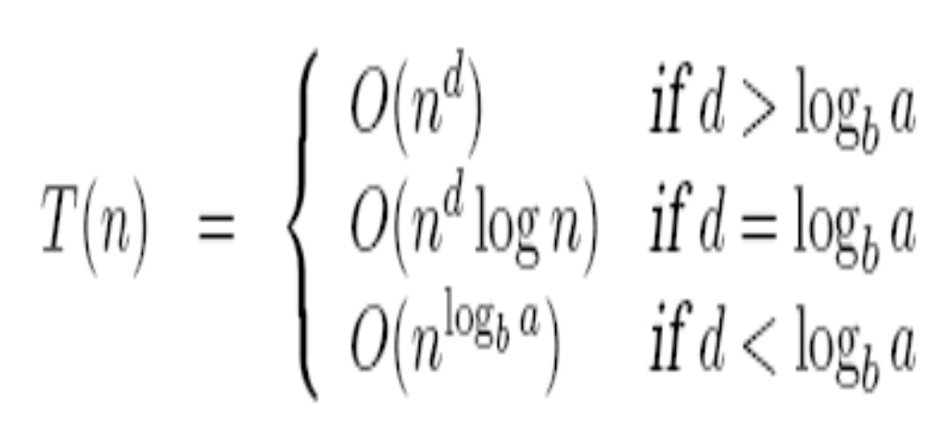

Slide 15
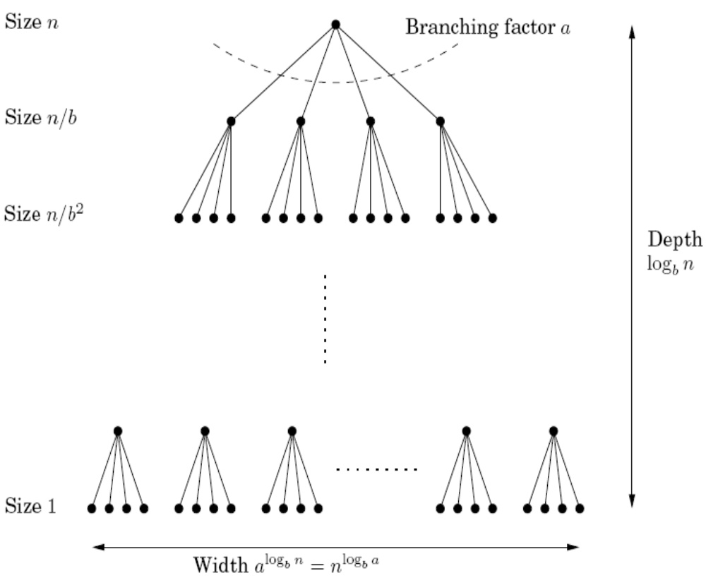
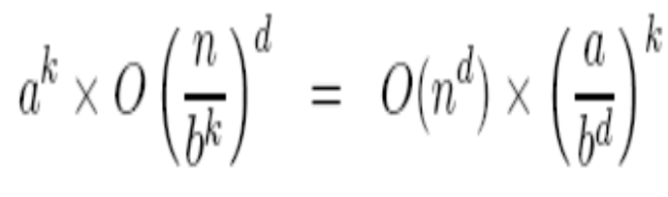
PROOF
Work Done at k^{th} Level
Total Work Done
Summation of the geometric series with ratio (a/b^{d}) and first term n^{d}

Slide 16
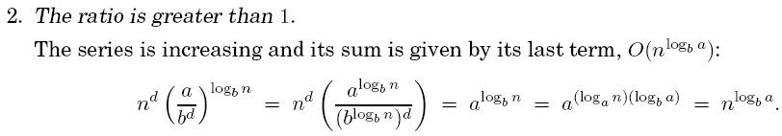
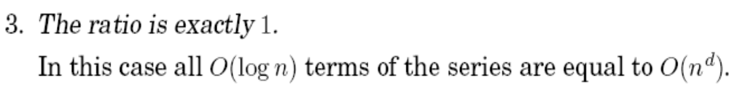
The Three Cases

Slide 17
THANK YOU
Any Questions?
SUMMARY
Merge Sort
  Optimum
Strassen’s Matrix Multiplication
  Improvable
Master Theorem

